Slide 1
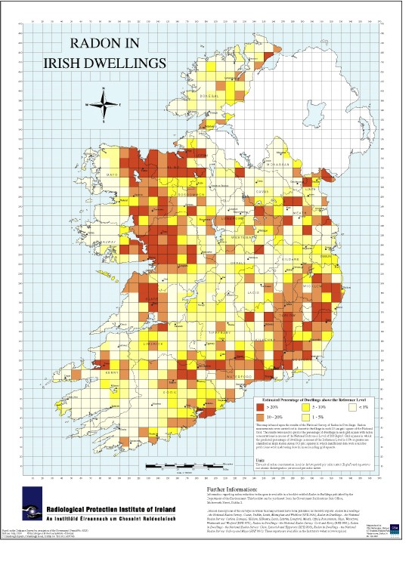


Local Authority Radon Measurement Programmes in Irish Social Housing
Stephanie Long, David Fenton and Alison Dowdall
Radiological Protection Institute of Ireland (RPII)
3, Clonskeagh Square, Clonskeagh Road, Dublin 14, Ireland
1. Introduction
As landlords, Local Authorities play an important role in assessing the radon risk to their tenants. This is especially true for tenants living in High Radon Areas. A High Radon Area is one in which it is predicted that 10% or more of all homes will exceed the Reference Level of 200 Bq/m³.
In recent years the RPII has worked closely with Local Authorities implementing radon measurement programmes in their social housing stock. An overview of the results of these programmes is presented here.
2. Objectives
This work had two main objectives:
To identify those Local Authority homes with radon concentrations above the Reference Level
To remediate those homes with elevated radon concentrations and so reduce the health risk to tenants
Radon risk map of Ireland indicating High Risk Areas
3. Methods
Cork County Council have measured their entire housing stock for radon. The RPII, Cork County Council and the Health Services Executive worked together to assess, communicate and tackle the radon problem identified. This experience was used to develop a template to provide guidance to other Local Authorities in carrying out this work¹. This template has been used by other Local Authorities to address radon in their housing stock. High Radon Areas have been prioritised for measurement and the results to date of this work are summarised below. Remediation programmes are underway in each area.
Summary of Local Authority radon measurements
Local Authority | No. of measurements | No. of homes >200 Bq/m³
Arklow Town Council | 378 | 2
Carlow County Council | 1,260 | 109
Cork County Council | 4,196 | 234
Galway City Council | 246 | 81
Kerry County Council | 457 | 6
Killarney Town Council | 335 | 35
Leitrim County Council | 136 | 5
Meath County Council | 376 | 9
Sligo Borough Council | 48 | 1
Sligo County Council | 100 | 5
Tralee Town Council | 190 | 93
Wicklow County Council | 2,374 | 47
Total | 10,096 | 627
4. Conclusions
To date, 10,096 Local Authority Homes have been measured for radon. This work has resulted in the identification of 627 homes above the Reference Level of 200 Bq/m³. Remediation of these homes is either in progress or complete. This dataset of Local Authority measurements is an important bank of information which improves our knowledge of the radon risk nationally. In addition, this work will have significantly reduced the radiation dose to Local Authority tenants.
References
1. RPII, 2009. Guidance notes to Local Authorities on implementing a radon measurement programme. Dublin: Radiological Protection Institute of Ireland.
Email: slong@rpii.ie

