Slide 1


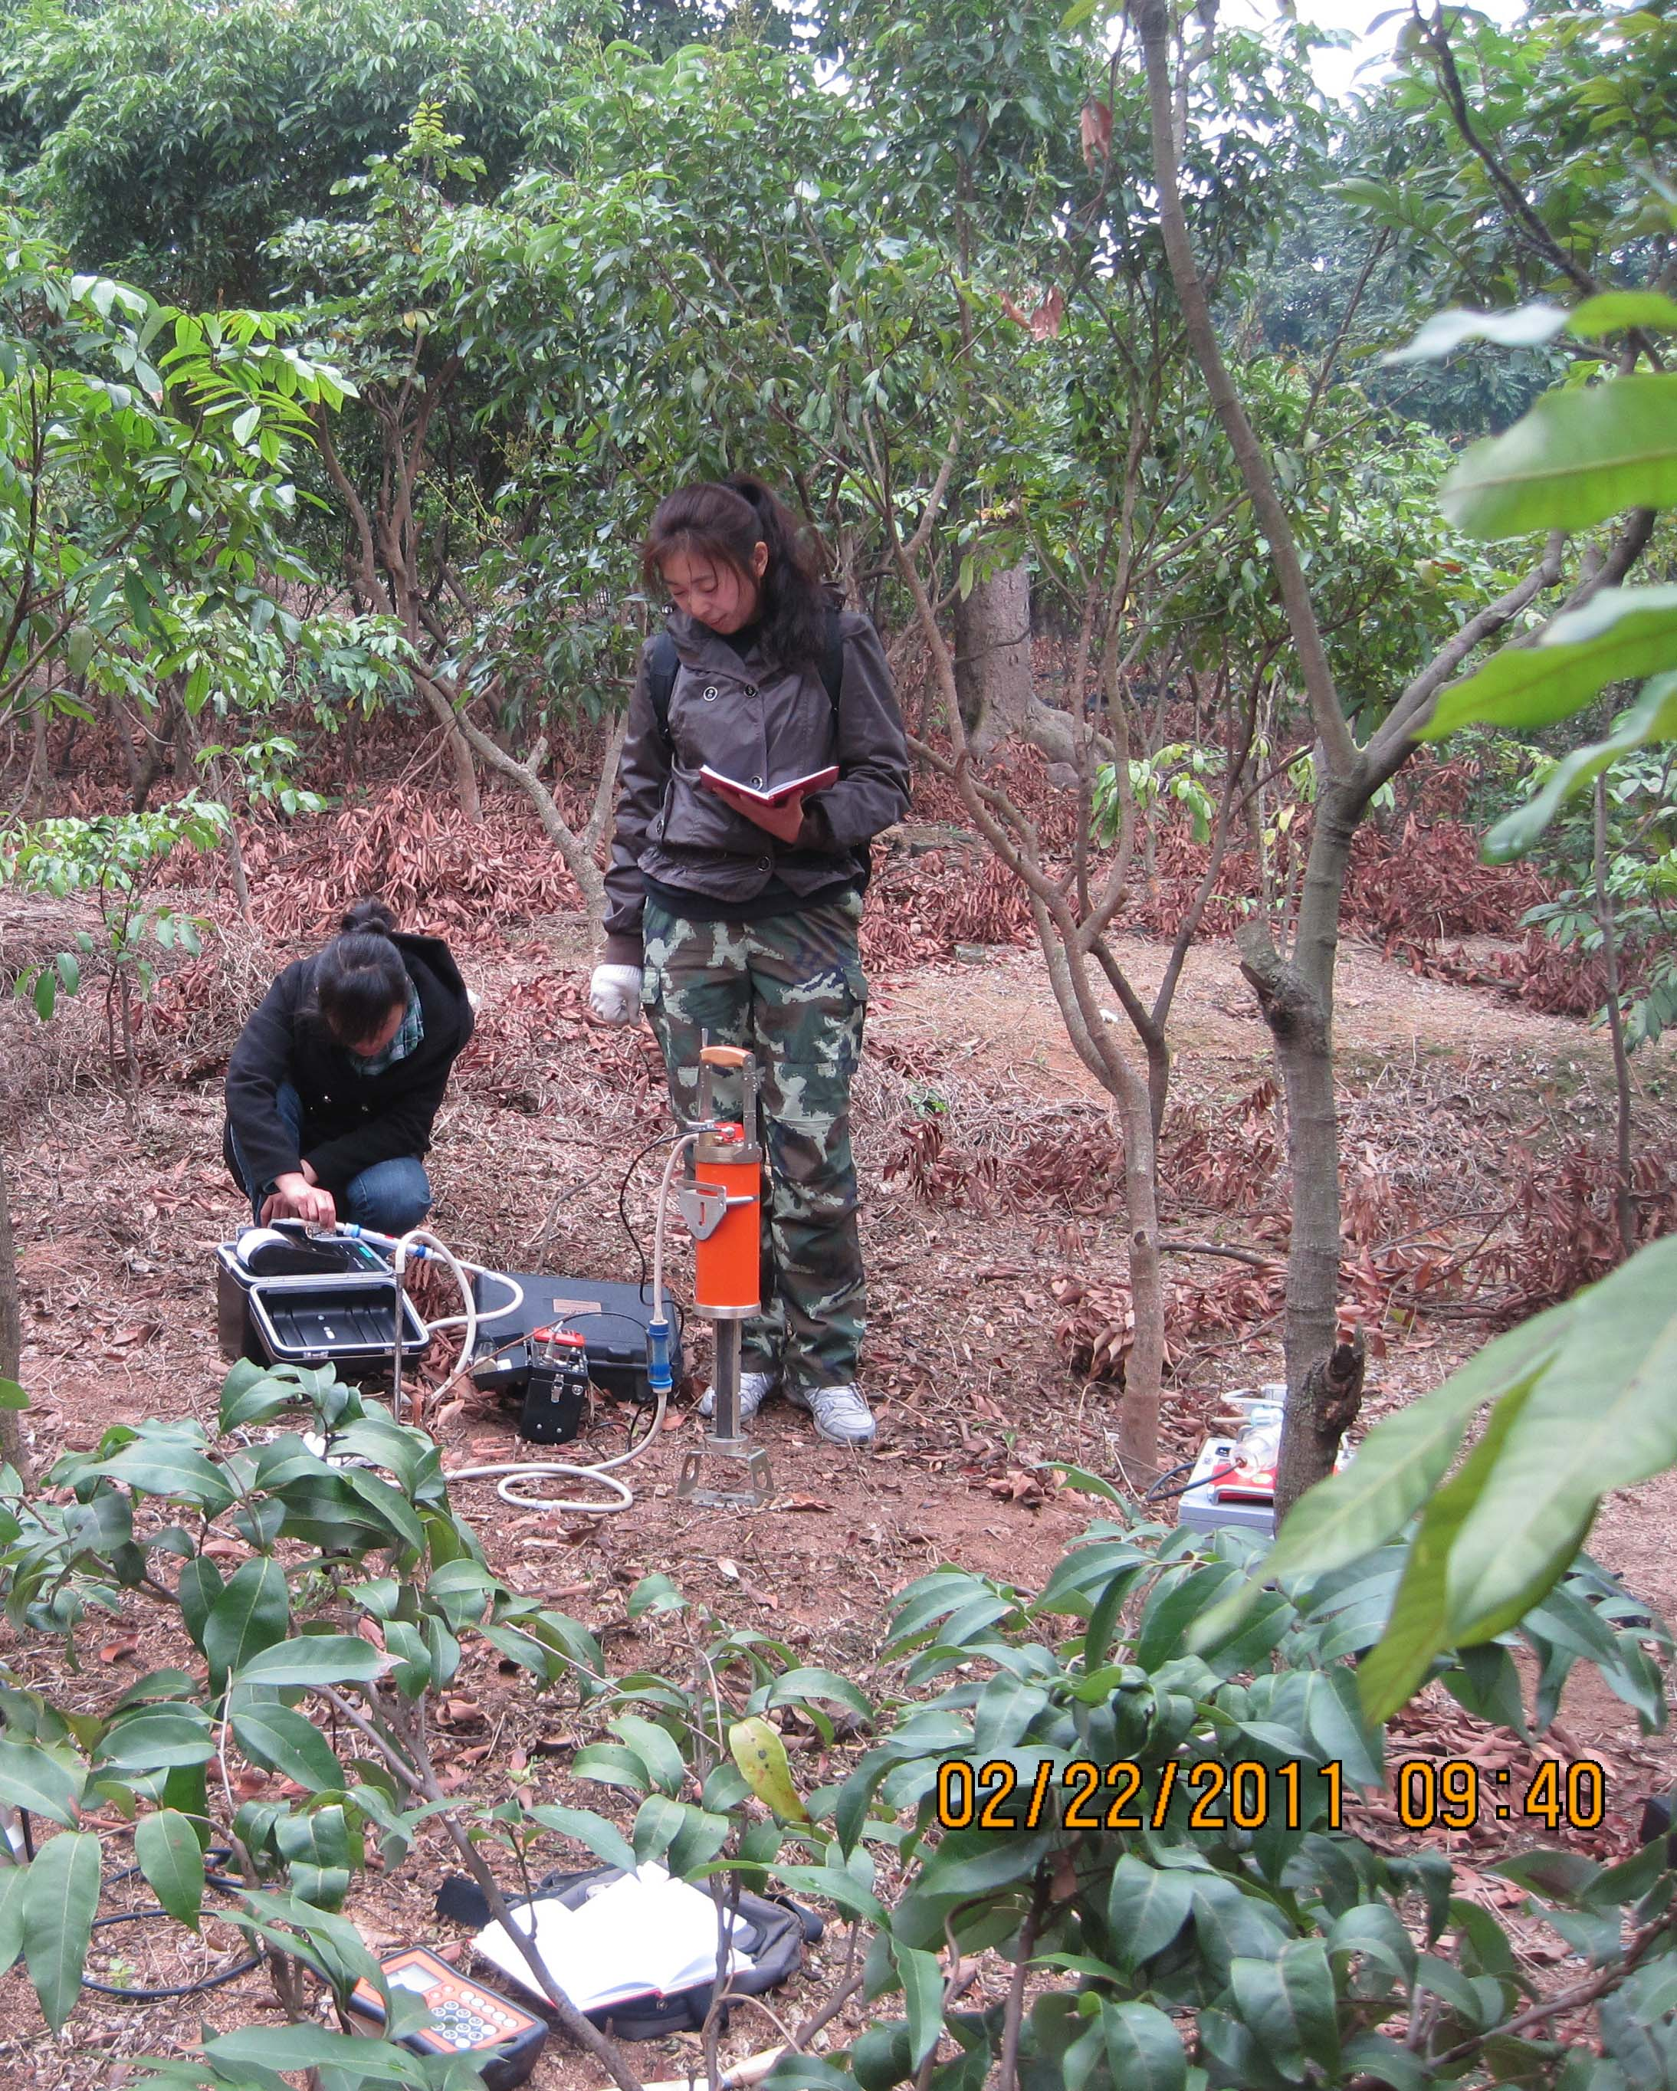
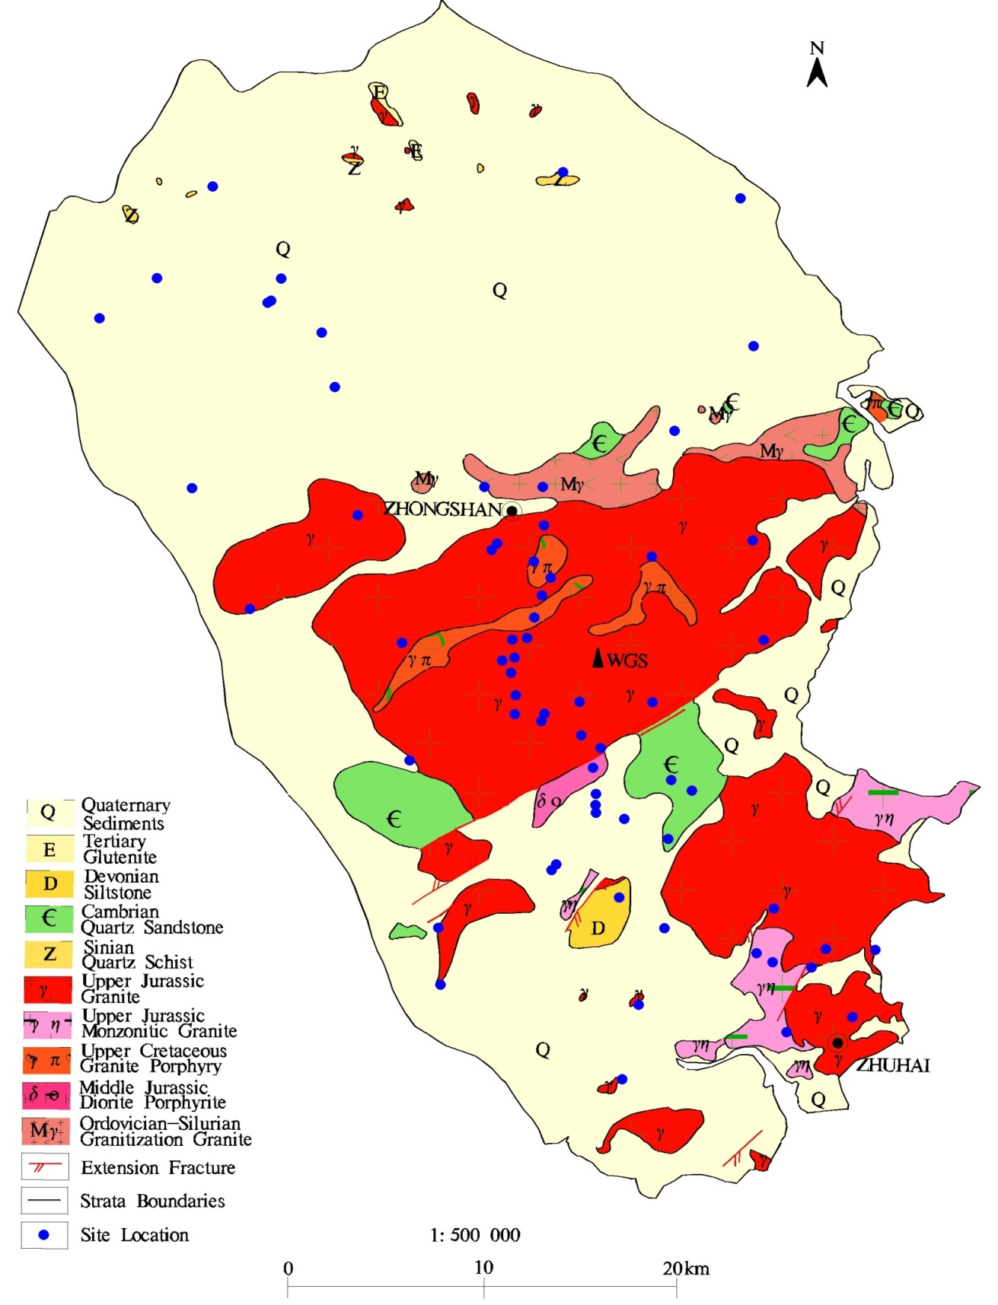

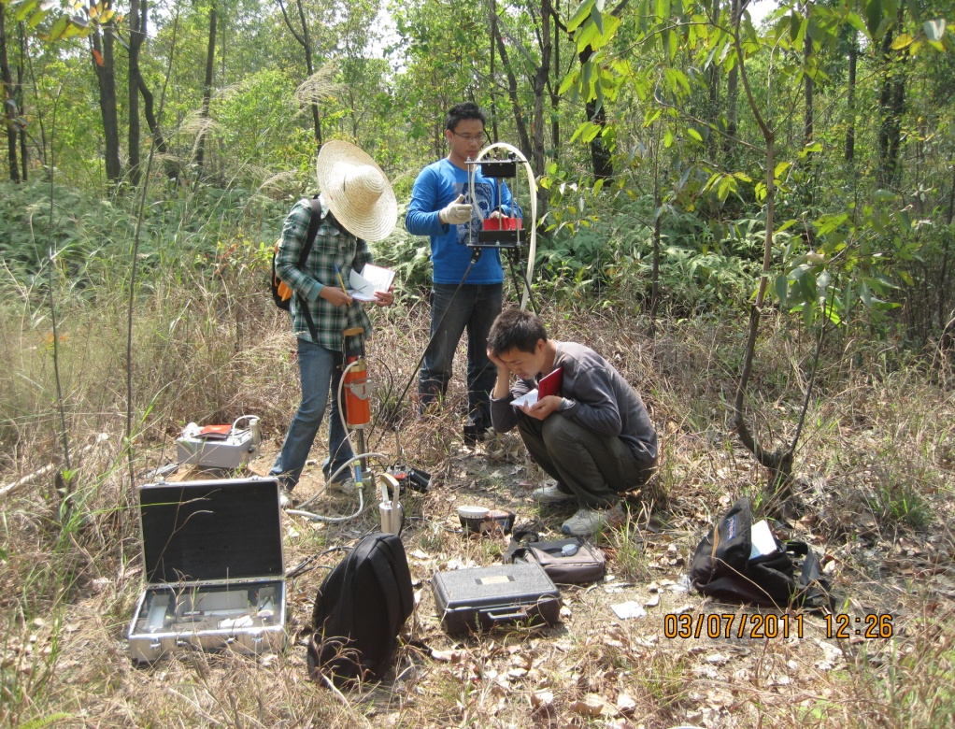
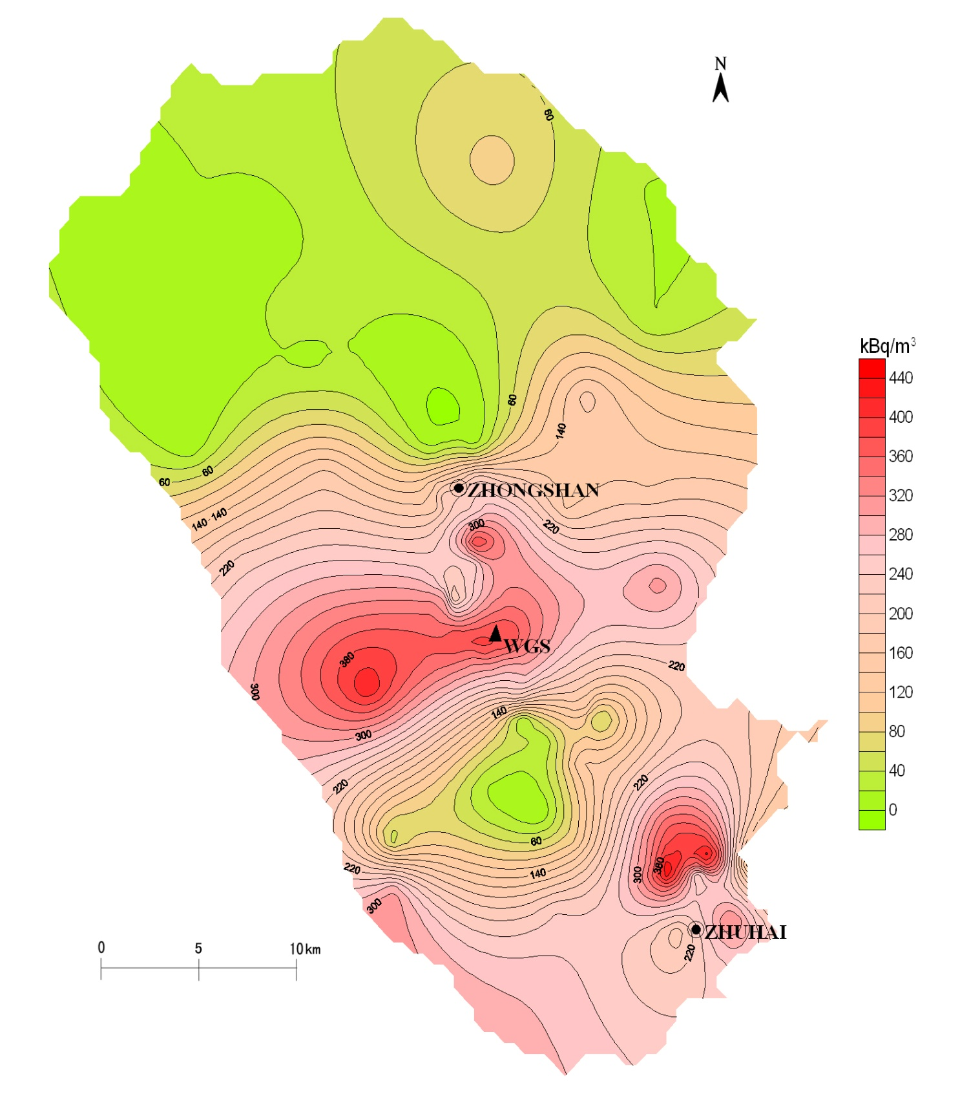
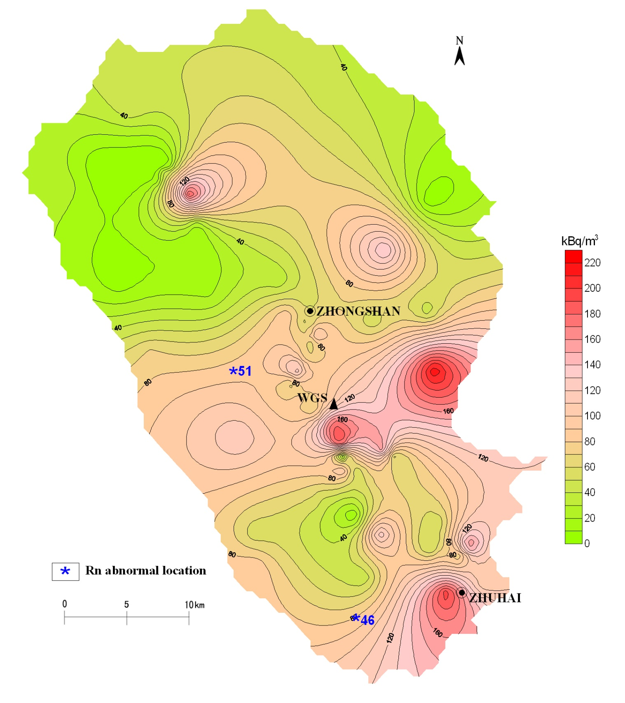
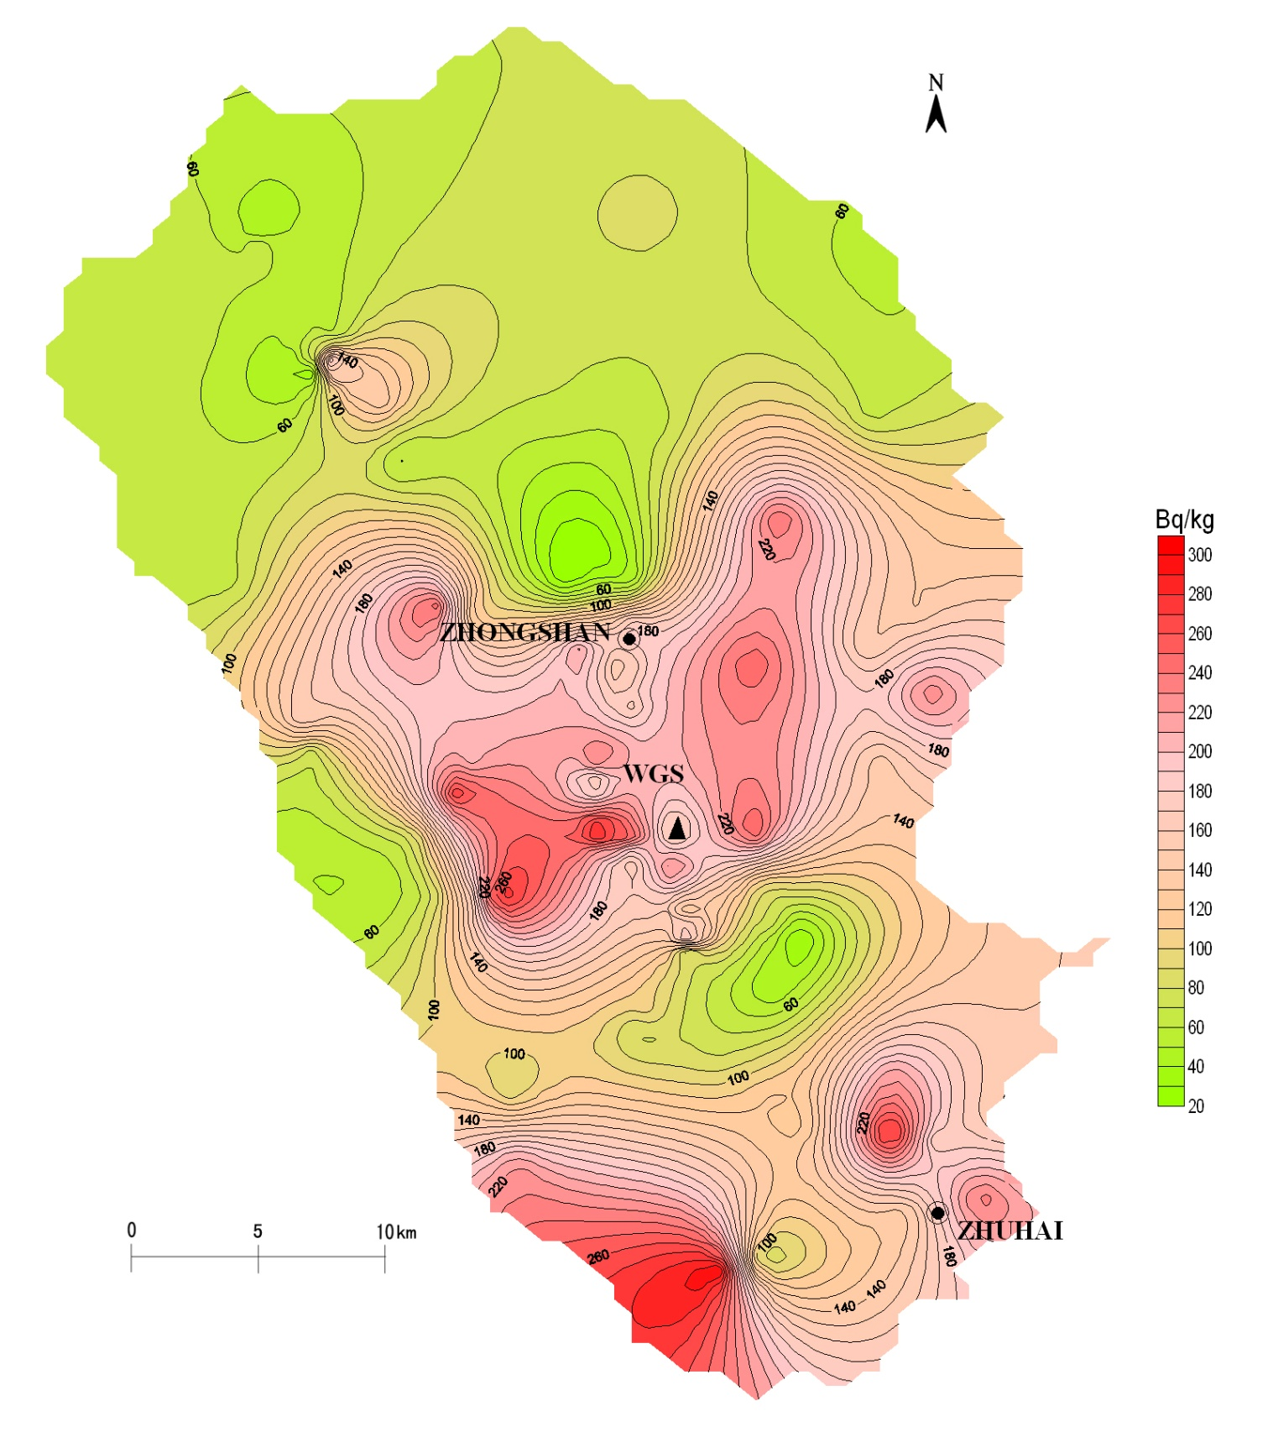
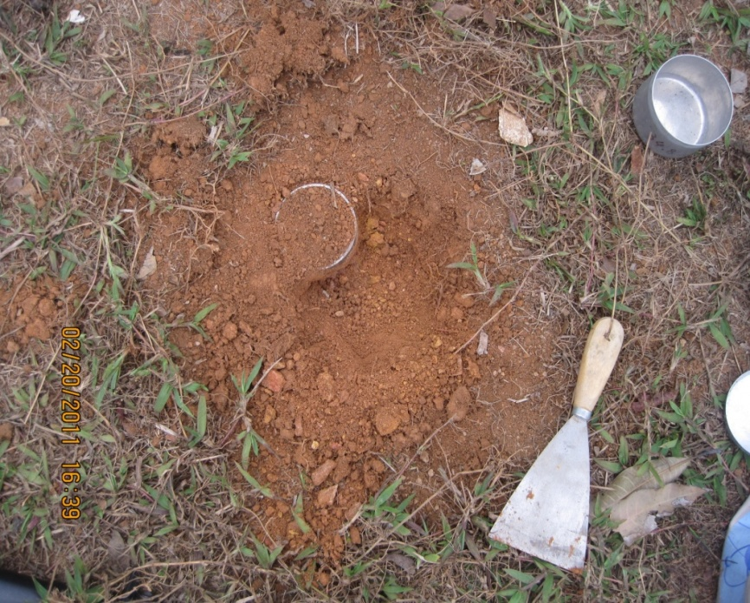
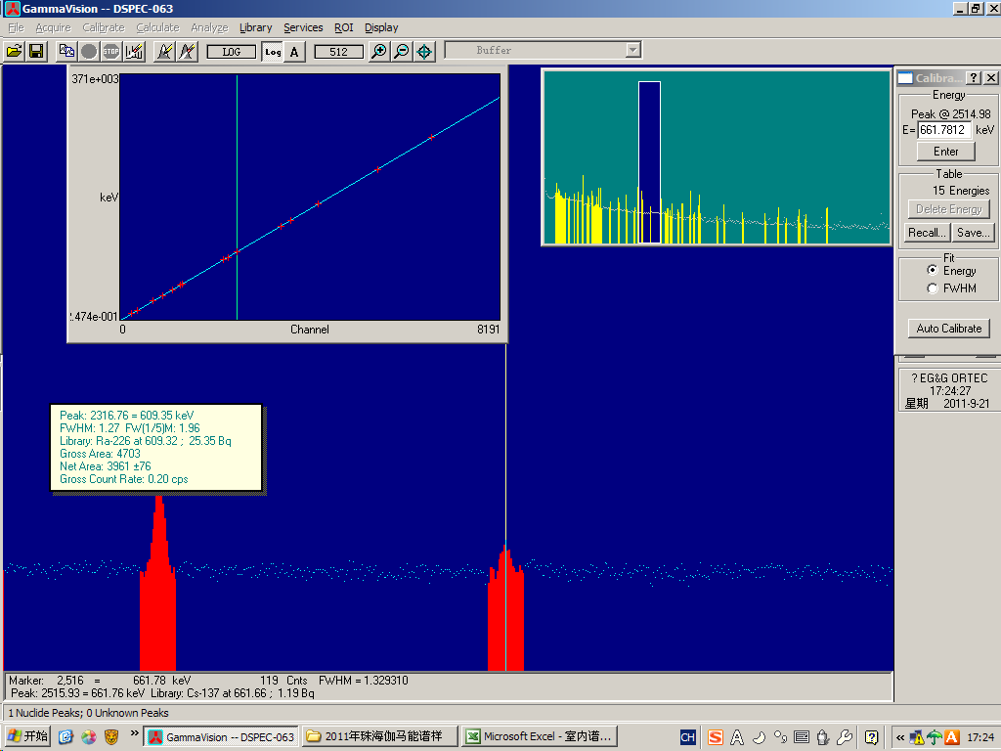
User ID 2356989
The Level and Distribution of ²²⁰Rn Concentrations in Soil Gas in Guangdong Province, China
Wang Nanping, Peng Aimin, Xiao Lei, Chu Xingming, Yin Yin and Qin Chunyan
School of Geophysics and Information Technology and Key Laboratory of Geo-detection (China University of Geosciences, Beijing), Ministry of Education, Beijing 100083, China; Email:npwang@cugb.edu.cn
Objective
²²⁰Rn concentrations survey was carried out for the first time using a RAD7 portable radon monitor in Zhuhai City and Zhongshan City, covered the total area of 1800 km² in South China in order to study on ²²²Rn/²²⁰Rn concentrations in soil gas and the correlation between ²²⁰Rn concentrations and ²³²Th activity contents and geological background.
Instrument and Method
Geological Overview and Measurement Locations
RAD7 RADON MONITOR
Detector: silicon
Internal sample cell: 0.7 L
Sampling time: 3 min.
Sampling depth: 80 cm
Flow rate: 1 L/min.
Mode: sniff
The surveyed area covered 1800 km², between 113⁰08' -113⁰37'E and 22⁰10' -22⁰46' N. Geological structure was relatively simple in Zhongshan City and Zhuhai City. The surface deposits that formed since the Late Quaternary mainly consist of arene, medium sized arentilla and arentilla or silty sand and silty clay-clay. The intrusive rocks appear as the Middle and Late Jurassic and Cretaceous biotitic-granite and granodiorite.
Fig. 1 Simplified geological map of surveyed area
Investigation results
Soil collection
A HPGe spectrometer
Fig. 2 Contour map ²²⁰Rn in soil gas
Fig. 3 Contour map ²²²Rn in soil gas
Fig. 4 Contour map of ²³²Th content
Fig. 6 The scatter plot of ²²²Rn and ²²⁰Rn
Conclusion and discussion
(1) The large scale soil radon survey results show that: soil gas ²²²Rn and ²²⁰Rn concentrations are relatively high in the regions of granite outcrops in Zhongshan City, Guangdong Province. ²²⁰Rn concentrations in soil were significantly different from that in the surface areas covered by weathered granite of Yanshan Period or Quaternary sediments. The ²²⁰Rn concentrations varied between 6.65 and 461 kBq/m³ and the average were 294.42±81.36 and 23.30±25.84 kBqm⁻³ for weathered granite products and sediments, respectively. The high positive correlation between ²²⁰Rn concentrations and ²³²Th activity contents was found. ²²⁰Rn concentrations had no statistically significant variations from depths of 20 to 140 cm with an interval of 20 cm.
(2) ²²⁰Rn measurement in the field using a RAD7 radon monitor is feasible, but we found that it is less efficient and normally takes 0.5h for each site if ²²²Rn is determined simultaneously.
(3) The data should provide valuable reference data for estimating annual effective dose due to absorption of ²²⁰Rn and its progenies to the Chinese public.
中国地质大学（北京）辐射与环境实验室 RADIATION AND ENVIRONMENT LABORATORY

