Slide 1
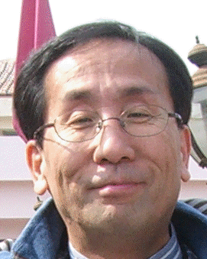
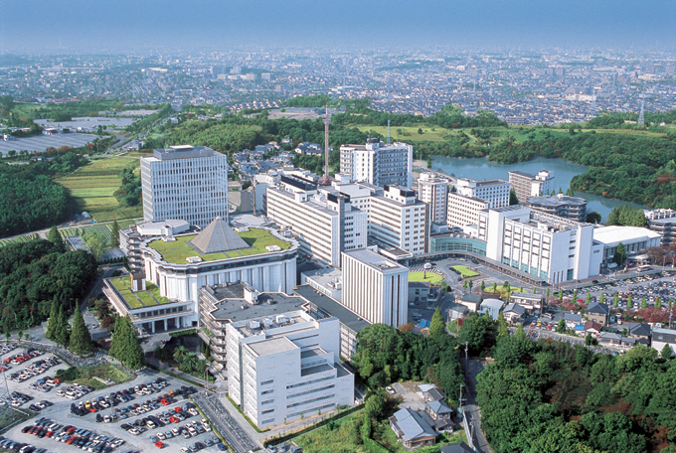
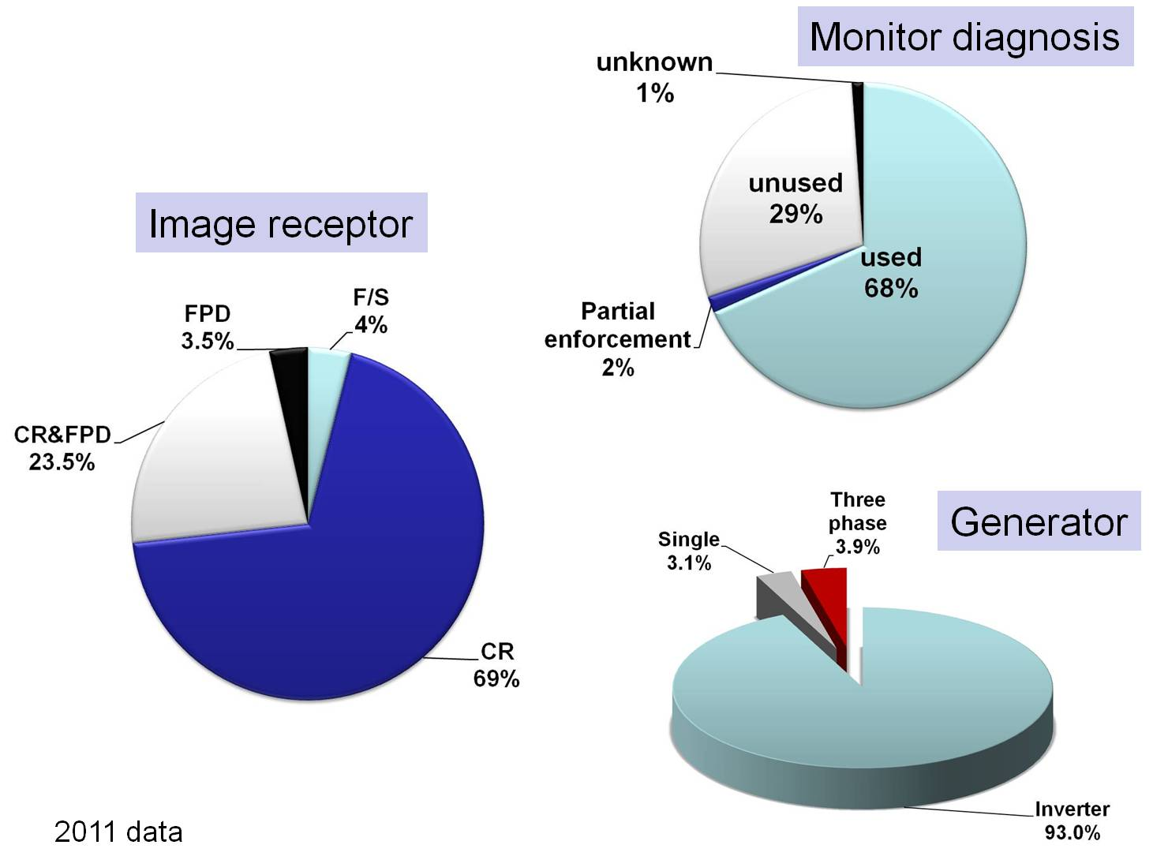
Trends in Patients’ Exposure Doses during Radiographic Examination in Japan
Shoichi Suzuki ¹ , Yasuki Asada ¹, Masanao Kobayashi² , Kenichi Kobayashi² , Yuuta Matsunaga³, Tomoko Otsuka⁴
¹School of Health Sciences, Fujita Health University, Aichi, 470-1192, Japan.
² Department of Radiology, Fujita Health University hospital,
³ Department of Radiology, Nagoya Kyouritsu Hospital
⁴Department of Radiology, Daido hospital
Shoichi Suzuki Ph.D.
E-mail : ssuzuki@fujita-hu.ac.jp
Address:1-98, Dengakugakubo, Kutukake-cho, Toyoake, Aichi, 470-1192, Japan
TEL: +81-562-93-4548、FAX: +81-562-93-4595
IRPA13 Abstract Notification: 2353112
1. Objective
Radiation doses received by patients during diagnostic radiography, especially x-ray radiography, have been reported by the United Nations Science Committee, but there are not many data from Japan. Consequently, we shall report the results of earlier surveys and the recent state of affairs regarding exposure during x-ray diagnosis. We shall also attempt to compare the data with the standards published by the IAEA. This report estimates the doses received by patients in the diagnostic x-ray area in Japan. In addition, digital radiography (CR) that computed radiography (CR) uses imaging plate (IP) and flat panel digital radiography (FPD) instead of the conventional film/ screens (F/S) is now being used at many medical institutions. Radiation dose comparisons between DR and F/S were also conducted.
2. Methods
2.1. Questionnaire surveys
Nationwide questionnaire surveys on the same items were carried out at medical institutions throughout the country where medical radiological technologists were employed. The surveys have been conducted a total of 9 times, the first time in 1974, and again in 1979, 1989, 1993, 1997, 2001,2003,2007 and 2011. The valid reply rate was about 35% of 3000 institutions.
2.2. Dose evaluation
Doses were evaluated based on the actual measured values at 100 institutions in the Chubu District. The entrance surface doses were calculated by classifying the values obtained by actual measurement from the exposure conditions for each of the generator types and filter thicknesses. Whenever the generator type was unknown, it was assumed to be 3-phase 12-peak, and whenever total filtration was unknown, it was assumed to be 3 millimeters aluminum equivalent. Mammography was evaluated by the average mammary glandular dose. The breast glandular and adipose tissue ratio to the air dose in the entrance surface area was calculated as 50%-50%, and the mammary glandular dose was calculated by multiplying this value by the mammany glandular absorbed-dose conversion coefficient for middle-aged women.
Table 1. Survey examination parts
*Examination for a typical adult patient
1. Head, frontal and lateral view 2. Cervical spine, frontal view
3. Thoracic spine, frontal and lateral view 4. Chest, low, quasi-high, high voltage
5. Lumber spine, frontal and lateral view 6. Abdomen, frontal view
7. Pelvis, frontal view 8. Femur, proximal 9. Forearm bones
10. Ankle 11. Guthmann 12. Maritius 13. Mammography
*Examination for a typical child patient
14. Hip, small child 15. Chest, small chiid 16. Chest, child
Table 2. Survey items and radiographic conditions
1.Generation type
2.Thickness of total filtration
3.Image receptor : F/S, CR, FPD
4.Tube voltage, tube current, exposure time
5.Grid ratio
6.Source surface distance
3. Results of the Surveys
Table 3 shows the numbers of institutions used to make the calculations, the 3/4 quantile doses (75 % doses), means, standard deviations, and IAEA guidance levels. The 75 % dose is the dose at the institution in the 75 % position, and it means that 75% of the institutions are at or below that dose. The 75 % doses were higher than the mean dose. Particularly at sites where the dose was large, i.e., the thoracic spine lateral view, lumbar spine lateral view and Martius sites, the 75% dose was about 1.5-2mGy larger than the mean. Comparisons with the guidance levels showed that all 9 sites were 1/2 to 1/6.The DR use rates in the 1997 survey were about 15%, in the 2007 survey were about 90% (Table 4-1). In the 2007 survey, the higher exposure dose was higher with CR (Table 4-2). The changes in doses at 10 representative sites in the body between 1974 and 2007 are shown in Table 5. The changes are shown by letting "100" represent the dose (%) at each site in 1974. During the 34-period the dose decreased 67% for “head, frontal view”, 51% for "lumbar spine, frontal view", 34% for 'lumbar spine, lateral view", -13 % for "chest, high voltage", 52% for "ankle". The dose for mammography decreased to 7%, less than 1/10 the dose in 1974. No large changes in doses were observed between the 2003 survey and the 2007 survey, but the doses were increased slightly. The DR use rates in the 1997 survey were about 15 %, in the 2011 survey were about 95 % (Table 4-1). In the 2011 survey, the higher exposure dose was higher with CR (Table 4-2). The changes in doses at 10 representative sites in the body between 1974 and 2011 are shown in Table 5. The changes are shown by letting "100" represent the dose (%) at each site in 1974. During the 37-period the dose decreased 76 % for “head, frontal view”, 62 % for "lumbar spine, frontal view", 57 % for 'lumbar spine, lateral view", 4 % for "chest, high voltage", 61 % for "ankle". The dose for mammography decreased to 7 %, less than 1/10 the dose in 1974. No large changes in doses were observed between the 2003 survey and the 2011 survey, but the doses were increased slightly.
Fig. 1. Type of image receptor, availability of diagnostic monitoring, and type of radiation generator.
Table 3. Exposure Sites Surveyed in 2011 and Dose Comparisons
Exposure sites | No.of institutions calculated | 75% dose | Mean | Standard deviation | IAEA Guidance level
Head, frontal view | 580 | 1.99 | 1.68 | 1.27 | 5
Head, lateral view | 575 | 1.55 | 1.31 | 1.10 | 3
Cervical spine, frontal view | 587 | 0.76 | 0.66 | 0.62 | -
Thoracic spine, frontal view | 576 | 2.81 | 2.32 | 1.93 | 7
Thoracic spine, lateral view | 574 | 5.99 | 4.70 | 5.20
Chest, low voltage | 198 | 0.40 | 0.35 | 0.36 | -
Chest, quasi-high voltage | 217 | 0.50 | 0.42 | 0.45 | -
Chest, high voltage | 634 | 0.24 | 0.23 | 0.33 | 0.4
Lumber spine, frontal view | 586 | 3.81 | 3.13 | 2.61 | 10
Lumber spine, lateral view | 585 | 12.82 | 9.68 | 6.71 | 30
Abdomen, frontal view | 602 | 2.32 | 2.04 | 2.27 | 10
Pelvis, frontal view | 585 | 2.54 | 2.01 | 1.52 | -
Femur, proximal | 579 | 1.59 | 1.29 | 1.07 | -
Forearm bones | 585 | 0.15 | 0.13 | 0.12 | -
Ankle | 585 | 0.20 | 0.17 | 0.17 | -
Guthmann | 287 | 6.27 | 4.51 | 4.95 | -
Maritius | 267 | 7.09 | 5.18 | 5.33 | -
Hip, small child | 385 | 0.17 | 0.15 | 0.17 | -
Chest, small chiid | 386 | 0.14 | 0.11 | 0.12 | -
Chest, child | 408 | 0.17 | 0.14 | 0.12 | -
Mammography | 468 | 1.91 | 1.58 | 0.48 | *3
*Withgrid: 3mGy (not classified according to whether a grid was used or not).
Table 4-1. X-ray examinations
X-ray examinations except mammography
 | 1997 | 2001 | 2003 | 2007 | 2011
Digital | 15.2 | 48.1 | 70.3 | 88.9 | 95.0
Film/Screen | 84.8 | 51.9 | 29.7 | 11.1 | 5.0
Mammography
 | 1997 | 2001 | 2003 | 2007 | 2011
Digital | 24.1 | 28.3 | 34.0 | 72.8 | 95.0
Film/Screen | 75.9 | 71.7 | 66.0 | 21.7 | 5.0
 |  |  |  |  | [ % ]
Table 4-2. CR, FPD and F/S doses
Chest (High voltage)
CR | n=495 | 0.24 | ± | 0.34 | mGy
FPD | n=111 | 0.18 | ± | 0.29 | mGy
F/S | n=19 | 0.12 | ± | 0.07 | mGy
Total |  | 0.23 | ± | 0.33 | mGy
Lumber spine, lateral view
CR | n=476 | 10.25 | ± | 6.83 | mGy
FPD | n=75 | 6.03 | ± | 5.02 | mGy
F/S | n=15 | 11.24 | ± | 7.19 | mGy
Total |  | 9.68 | ± | 6.71 | mGy
Forearm bones
CR | n=526 | 0.128 | ± | 0.052 | mGy
FPD | n=16 | 0.134 | ± | 0.242 | mGy
F/S | n=13 | 0.107 | ± | 0.057 | mGy
Total |  | 0.127 | ± | 0.122 | mGy
Table 6. Percentages of units used for generating radiography in 1994 to 2011
 | 1994 | 1997 | 2001 | 2003 | 2007 | 2011
Single phase | 18 | 17 | 9 | 8 | 5 | 5
Three phase | 41 | 30 | 16 | 8 | 4 | 4
Inverter type | 39 | 47 | 70 | 80 | 85 | 85
Constant voltage | 1 | 1 | 0 | 0 | 0 | 0
Unknown | 1 | 5 | 5 | 4 | 6 | 6
Table 5. Exposure Doses for Imaging at 10 Sites in Body - Changes between 1974 and 2011 -
Exposure sites | 1974 | 1979 | 1989 | 1993 | 1997 | 2001 | 2003 | 2007 | 2011
 | Dose | Dose | Dose | Dose | Dose | Dose | Dose | Dose | Dose
Head, frontal view | 7.11 | 5.34 (75) | 3.84 (54) | 2.49 (35) | 2.28(32) | 2.18 (31) | 2.14 (30) | 2.39 (34) | 1.68 (24)
Lumber spine, frontal view | 8.21 | 5.99 (73) | 4.19 (51) | 3.61 (44) | 3.63 (44) | 3.40 (41) | 4.52 (55) | 4.06 (49) | 3.13 (38)
Lumber spine, lateral view | 22.30 | 15.61 (70) | 9.37 (42) | 10.48 (47) | 11.08 (50) | 8.62 (39) | 9.85 (44) | 11.34 (51) | 9.68 (43)
Pelvis, frontal view | 6.74 | 5.12 (76) | 3.10 (46) | 2.49 (37) | 2.42 (36) | 2.41 (36) | 2.52 (37) | 3.12 (46) | 2.01 (30)
Chest, high voltage | 0.23 | 0.18 (78) | 0.13 (57) | 0.13 (57) | 0.18 (78) | 0.21 (91) | 0.22 (96) | 0.26 (113) | 0.22 (96)
Ankle | 0.44 | 0.31 (70) | 0.21 (48) | 0.17 (39) | 0.21 (48) | 0.20 (45) | 0.19 (43) | 0.21 (48) | 0.17 (39)
Hip, small child | 0.50 | 0.37 (74) | 0.23 (46) | 0.12 (24) | 0.13 (26) | 0.19 (38) | 0.14 (28) | 0.19 (38) | 0.15 (30.0)
Chest, small chiid | 0.56 | 0.39 (69) | 0.24 (43) | 0.12 (21) | 0.18 (32) | 0.13 (23) | 0.10 (18) | 0.18 (32) | 0.11 (20)
Guthmann | 24.26 | 16.74 (69) | 7.28 (30) | 5.58 (23) | 6.49 (27) | 6.26 (26) | 4.30 (18) | 5.65 (23) | 4.51 (19)
Mammography | 22.50 | 10.35 (46) | 4.28 (19) | 1.80 (8) | 1.42 (6) | 1.46 (6) | 1.44 (6) | 1.61 (7) | 1.58((7)
Fig. 2. The doses of representative 4 sites (1974-2011)
5. Conclusion
We have reported on the current situation regarding the doses received by patients who undergo diagnostic radiography examinations in Japan based on the results of surveys conducted over a 33-year period. Reductions in the doses were observed, but there is still a good deal of room for improvement. Physicians, dentists, and radiological technologists who are responsible for radiation therapy carry a heavy burden. Faced with the prospect of digitalization in the future, efforts must be made to decrease exposure so that the doses do not become even higher than they are now. We hope that this report has served as an opportunity for you to learn about the current situation regarding the radiation doses to which patients are exposed during diagnostic radiography.

