Slide 1
A Story of T
Richard V. Osborne
International Radiation Protection Association
Glasgow
2012 May 14

Slide 2
Why tritium?
Continuing public interest
Complementary to conference theme
Most of my R&D at Chalk River Nuclear Laboratories
Illustrates the wide range of disciplines in radiological protection
Areas where research is needed
Issues have broader application

Slide 3
A Story of T
Overview of tritium
Early days
Measurement
Biokinetics and dosimetry
Relative biological effectiveness
Dispersion in the environmental
Health effects
Effluent management
Summary

Slide 4
117
4
3
2
1
Z
Chart
of the
Nuclides
⁵Li
⁶Li
³He
⁴He
⁵He
¹H
²H(D)
³H(T)
³H(T)
0 1 2 3 4 177
N

Slide 5
Tritium ³H (T)
³He
+ e⁻ + ν_{e}
Half life 12.32 years
Energy 18.6 keV max
5.7 keV mean
Range 6 mm in air
0.006 mm in tissue
Beta decay
³H(T)

Slide 6
Tritium
Production
Cosmic ray neutrons on ¹⁶O and ¹⁴N
Fission in nuclear reactors and weapons
Neutron capture by D (²H) and (n,p) on ³He in heavy water reactors
Neutron capture by ⁶Li in reactors
Environment
72 PBq/a
0.2-1 Bq/L
13 PBq/a
Uses
Nuclear fusion research
Thermonuclear weapons
Biochemical and hydrological research
Light sources
186,000 PBq
HT
HTO
OBT

Slide 7

Early Days
Oliphant, Harteck & Rutherford.
Nature 133, 413 (1934)
Transmutation Effects observed with Heavy Hydrogen
“. . . diplons have been used to bombard preparations . . . in which the hydrogen has been displaced in large part by diplogen.”
. . .
“While the nuclei of ₁H³ and ₂He³ appear stable for the short time required for their detection, the question their permanence requires further consideration”

Slide 8
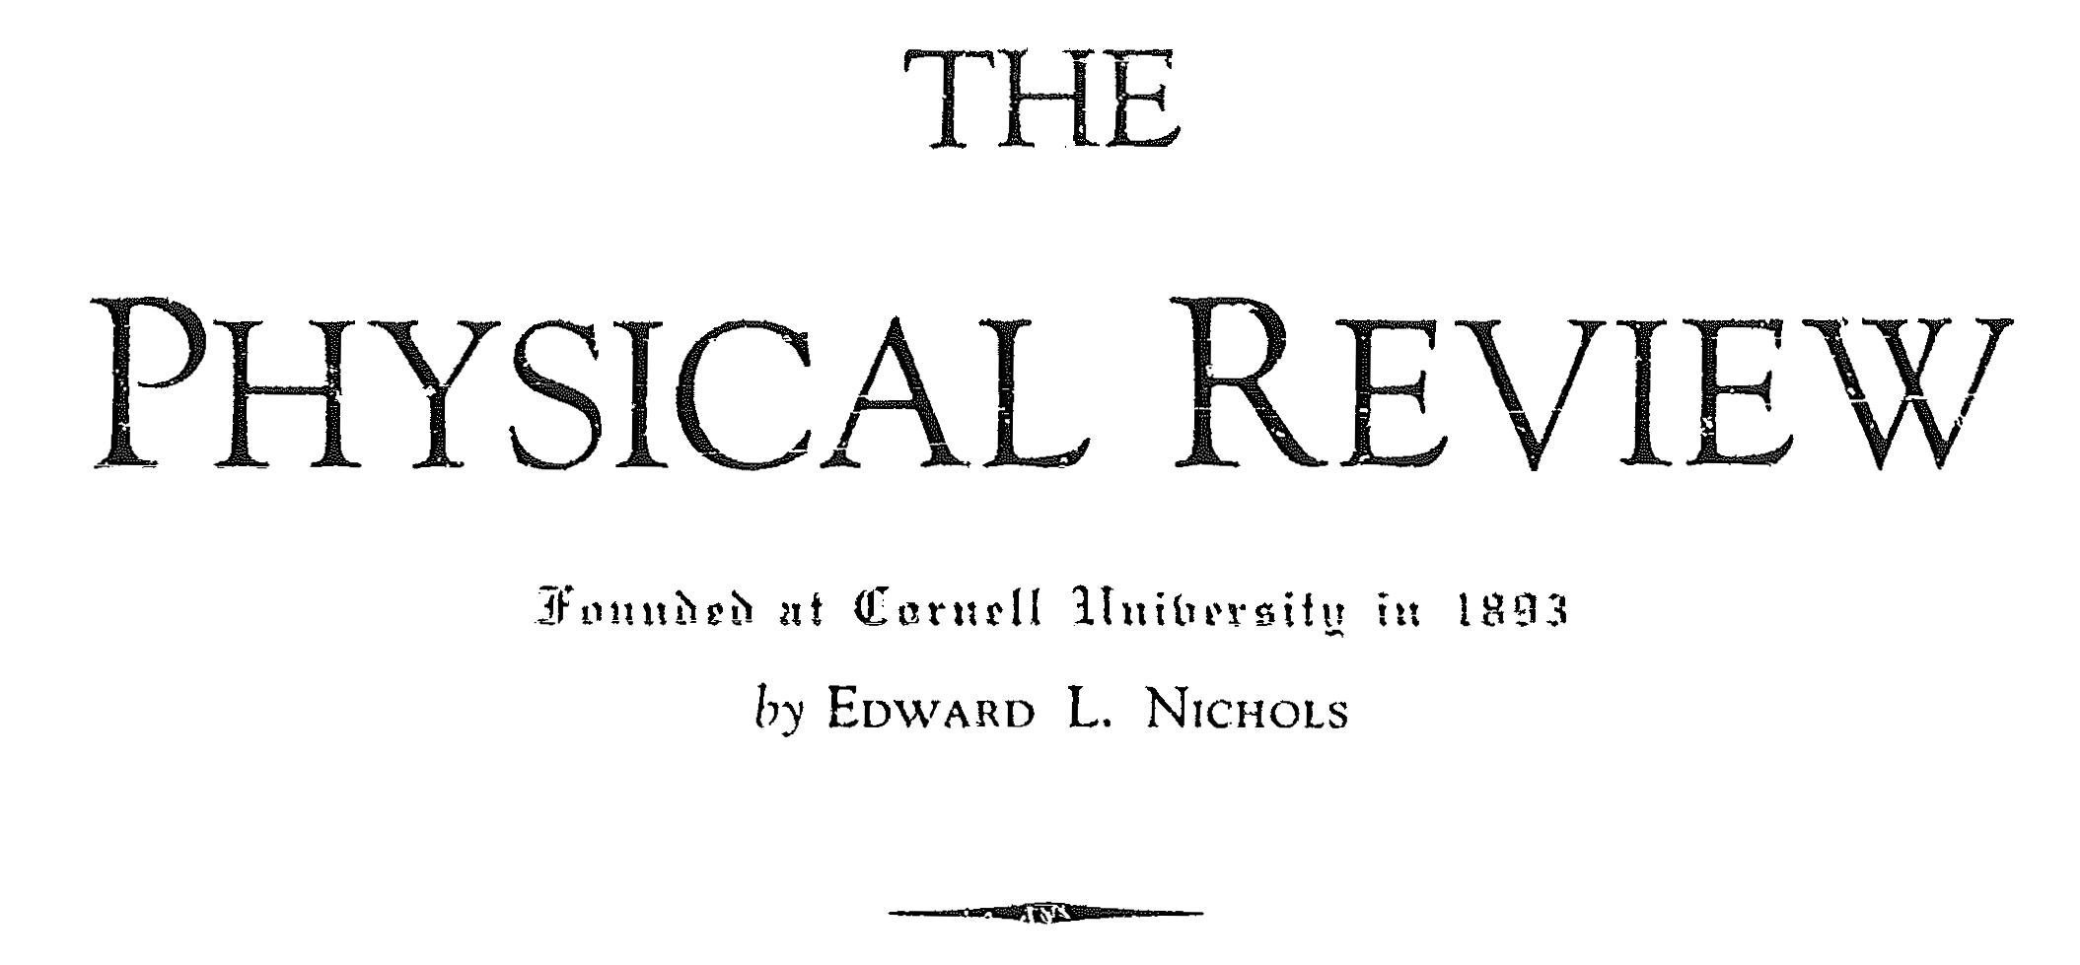
Early Days
Alvarez & Cornog.
Phys. Rev. 56 613 (1939)
Helium and Hydrogen of Mass 3
“Since we have shown that He³ is stable, it seemed worthwhile to search for the radioactivity of H³. . .The radiation emitted by this hydrogen is of very short range.”

Slide 9
Early Days
Late1940s – 1950s
Natural tritium detected
Tritium as a tracer for atmospheric circulation patterns and in hydrology
Faltings & Harteck. Zeitschrift für Naturforschung 5A 438 (1950)

Slide 10
Early Days
1950s – 1960s
Tritium from weapons testing measured in precipitation
700
600
500
400
300
200
100
0
Ottawa
Bq/L
‘53 ‘55 ‘57 ‘59 ‘61 ‘63 ‘65
Year
IAEA. Environment Isotope Data No. 1 (1969); No. 2 (1970)

Slide 11
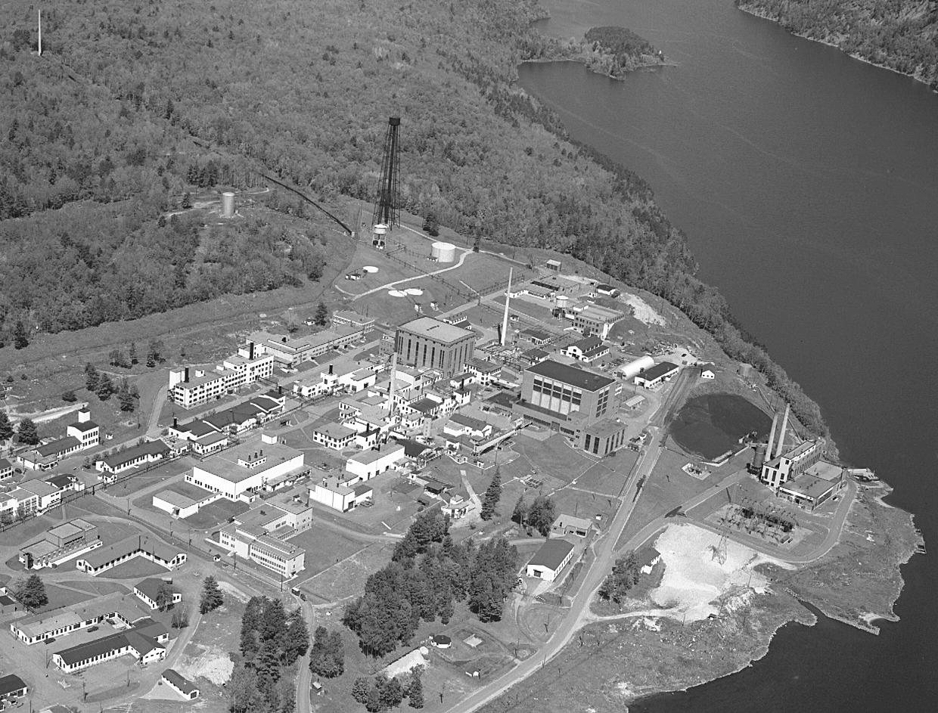
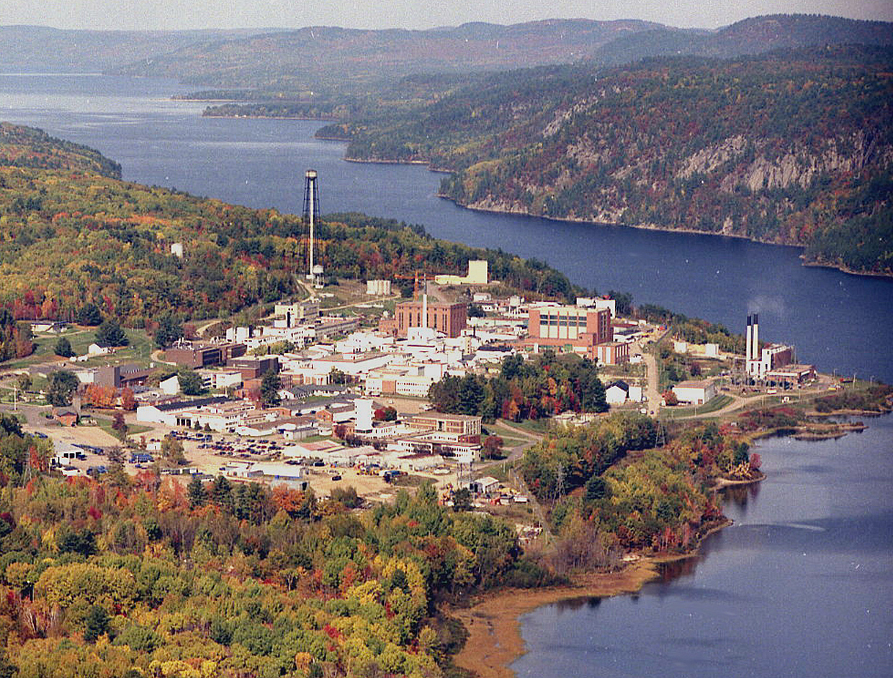
Early Days
1950s – 1960s
Occupational doses from tritium
Savannah River, USA
First of five reactors; HW moderated and cooled
~1962
Workplace concerns in the early 1960s:
          Measurement and monitoring
          Skin absorption
          Dosimetry
AECL Chalk River Nuclear Laboratories, Canada
NRX; HW moderated; NRU; HW moderated and cooled

Slide 12
Measurement
Adequate sensitivity:
Constraint of short range of tritium beta
Discrimination against:
Gamma
Noble gases (e.g., ⁴¹Ar, ⁸⁷Kr,¹³³Xe)
Air monitoring needs:
Practical
“Handsome is as handsome does”
Chaucer. Canterbury tales (~1387)
Development late 1950s into 1980s in R & D laboratories
Basis for current methods
NCRP. Tritium measurement techniques, Report 47 (1976)
Wood et al. Health Phys. 65 610 (1993)
Marsh. Development of techniques . . . for tritium analysis. PhD thesis, University of Southampton. (2010)

Slide 13
Measurement
Detection in
gaseous phase
HT/HTO
Flow-through
detectors
Ionization chamber
Proportional counter
Plastic scintillator
Solid state detector

Slide 14
Measurement
Detection in
gaseous phase
HT/HTO
Flow-through
detectors
Ionization chamber
Proportional counter
Plastic scintillator
Solid state detector

Slide 15
Measurement
Flow through ionization chamber
1 Bq tritium produces 25 aA
1 DAC (0.3 MBq/m³)
1 litre ionization chamber gives 7.5 fA
40 litre . . . . . . . . . . . . . . . 0.3 pA
Same current from 0.8 µSv/h gamma

Slide 16
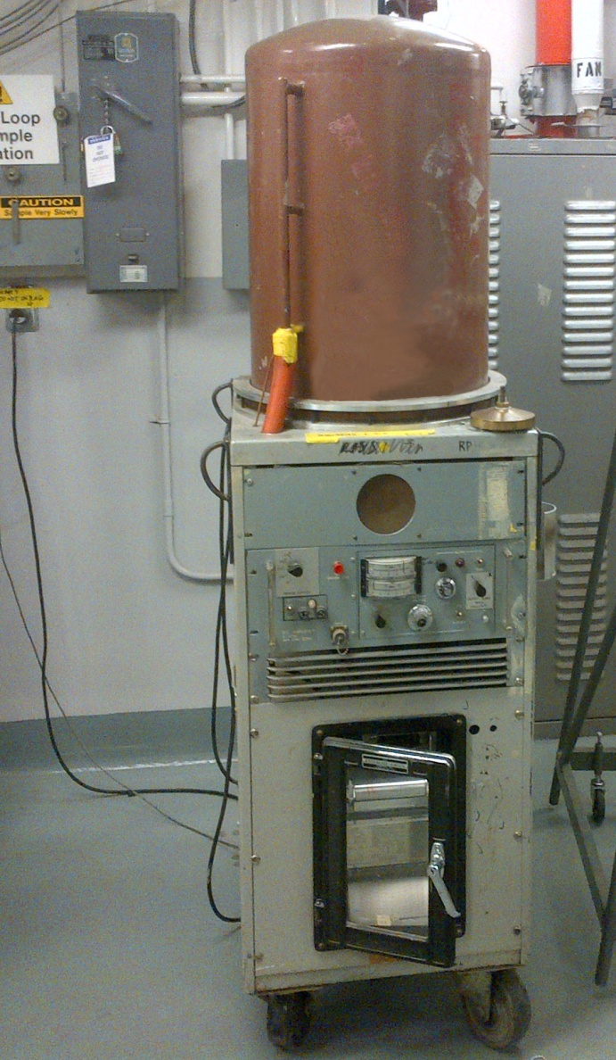
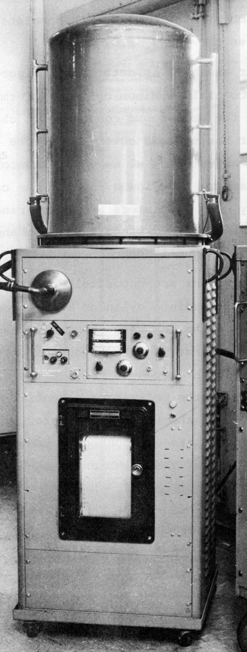

Measurement
Flow through ionization chamber
40 L volumes
HTO plus gamma
chamber
Gamma
chamber
98%
gamma
cancellation
Noble gases:
⁴¹A 5 x ionization
Air in
+
-
Air out
Net current
2012 March, Chalk River
40L ionization chamber in operation
Cowper and Osborne. Measurement of tritium in air in the presence of gamma radiation. Proc. First Int. Cong. Rad. Prot. (1966)

Slide 17

Measurement
+
-
Compensation
for gamma and
noble gases
-
+
Air out
Air out
Measured
compensation ~ 99%
Air in
Desiccant
Net Current
Osborne and Coveart. Proc. of 4th IRPA Congress, Paris, France, (1977).

Slide 18
Measurement
Detection in
gaseous phase
HT/HTO
Detection in liquid phase
HTO
Flow-through
detectors
Air/water
continuous
flow
exchanger
Ionization chamber
Proportional counter
Plastic scintillator
Solid state detector
Plastic scintillator
Liquid scintillator

Slide 19
Measurement
Continuous water flow exchanger
1960s & ‘70s electronics for control and counting systems —in house design
e.g, 4 decade digital ratemeter
Sampled air
(HTO,NG)
Water
Exchange
Air (NG)
Osborne. IEEE Trans. on Nucl. Sci. NS-22: 1952 (1975)
Purge
Water (HTO) to plastic
scintillator detector
Purge air
Detect down to ~0.1 DAC
Osborne. IEEE Trans. on Nucl Sci. NS-22: 676 (1975)

Slide 20
Measurement
Liquid scintillator exchanger
Discrimination against noble gases and HT
> 5400 for ^{133,135}Xe >1400 for HT
Liquid scintillator
+H₂O + HTO out
Air flow out
Liquid scintillator
+ H₂O in
Air flow +HTO in
Nafion tubing
Osborne & McElroy. Management of Gaseous Wastes from Nuclear Facilities, IAEA (1980)

Slide 21
Measurement
Detection in
gaseous phase
HT/HTO
Detection in liquid phase
HTO
Flow-through
detectors
Air/water
continuous
flow
exchanger
Air sampling
Bubbler, Diffuser
Freeze-out, Desiccant
Ionization chamber
Proportional counter
Plastic scintillator
Solid state detector
Plastic scintillator
Liquid scintillator
Liquid scintillator
Mass spectrometer

Slide 22

Measurement
Passive diffuser sampler
Screen
Diffusion tube
(1 or 5 L/d)
Capped 20 mL
scintillation vial
Wet-proofed
catalyst
for HT/HTO conversion
Water/glycol mix
Stephenson. Health Physics 46 718 (1984)
Surette & Nunes. Fusion Sci. & Tech. 48 393 (2005)

Slide 23
Measurement
Detection in
gaseous phase
HT/HTO
Detection in liquid phase
HTO
Flow-through
detectors
Air/water
continuous
flow
exchanger
Air sampling
Bubbler, Diffuser
Freeze-out, Desiccant
Bubbler, Diffuser
Freeze-out, Desiccant
Ionization chamber
Proportional counter
Plastic scintillator
Solid state detector
Ionization chamber
Proportional counter
Plastic scintillator
Solid state detector
Liquid scintillator
Mass spectrometer
Liquid scintillator
Plastic scintillator
Liquid scintillator
Liquid scintillator
Mass spectrometer
Plastic scintillator
Liquid scintillator
40,000 – 3,000
30,000
300
Bq/m³
30
2 – 0.002
DAC = 300,000 Bq/m³
0.00001
Natural 0.01

Slide 24
Biokinetics and Dosimetry
Issues:
  Intake through the skin
  Doses from OBT
  Dose from tritium on surfaces
  Doses from tritiated particles
  Interpretation of bioassay results
Internal dosimetry estimates at Chalk River meeting in 1949
  First “standard man” parameters
  370 MBq max. body burden for limit of ~ 3mSv/week
Permissible doses tripartite conference (Canada/USA/UK)
Chalk River, Ontario, Canada (1949)

Slide 25
Biokinetics and Dosimetry
Intake through the skin
Forearm
Abdomen
Whole body
Air volume
containing tritium absorbed
L/(min.m²)
12
Pinson and Langham.
J. Appl. Physiol. 10 108 (1957)
Year

Slide 26
Biokinetics and Dosimetry
Intake through the skin
Exposure times 5 – 60 min
Breathing rate equivalent
to whole body intake rate 9.7 L/min
Forearm
Abdomen
Whole body
Air volume
containing tritium absorbed
L/(min.m²)
17
Osborne.
Health Phys. 12,1527 (1966)
Year

Slide 27
Biokinetics and Dosimetry
Intake through the skin
Exposures 6 s – 40 min
Analysis of desorption curves
Fickian diffusion kinetics followed
Delay times ~ 10 min
Forearm
Abdomen
Whole body
Air volume
containing tritium absorbed
L/(min.m²)
6
Osborne.
IAEA/OECD Symp. SM-232/43 (1979)
Year

Slide 28
Biokinetics and Dosimetry
Intake
Excretion
Most, very quickly
HT
Breath
Small fraction
Peterman et al.
Fusion Technology 8 2557 (1985)
Urine
Breath moisture
Perspiration
10 day halftime
HTO
Reviews:
Canadian Nuclear Safety Commission. INFO-0799 (2010)
Harrison et al. Rad. Prot. Dosim. 98 299 (2002)
Urine
Faeces
OBT
OBT
Tritiated
particles
Faeces
HT from
Surfaces

Slide 29
Biokinetics and Dosimetry
Dose from OBT after HTO intake
100 M
10 M
1 M
100 k
10 k
1 k
Bq/L
in
urine
0 50 100 150 200 250 300
Days
Snyder et al. Phys. Med. Biol. 13, 547 (1968)

Slide 30
Biokinetics and Dosimetry
Dose from OBT after HTO intake
100 M
10 M
1 M
100 k
10 k
1 k
Bq/L
in
urine
0 50 100 150 200 250 300
Days
Snyder et al. Phys. Med. Biol. 13, 547 (1968)

Slide 31
Biokinetics and Dosimetry
Typical multi-compartment model
Organic
Mass M₁
T₁
Intake of HTO
Body Water
T₂
Organic
Mass M₂
T₃
Bone
Mass M₃
T₄
Excretion
T₅
Bone
Mass M₄
Killough. ORNL-5853 (1982)

Slide 32
Biokinetics and Dosimetry
J. von Neumann:
“With four parameters I can fit an elephant . . .
and with five I can make him wiggle his trunk.”

Slide 33
Biokinetics and Dosimetry
Back to basics
HTO
Time
Organic Component A
Organic Component B

Slide 34
Biokinetics and Dosimetry
Two parameters needed to estimate dose:
  Faction of organically bound hydrogen labelled with tritium (20–30%)
  Water fraction in tissue (60–80%)
  Dose from OBT 5–20% of dose from HTO
Verified by direct measurement of OBT excreted by workers:
Dose from OBT 6.9 ± 3.1% of dose from HTO
Pinson and Langham. J. Appl. Physiol. 10 108 (1957)
Osborne. Rad. Res. 50, 197-211 (1972)
Trivedi, Galeriu, & Lamothe. Health Phys. 78, 2 (2000)

Slide 35
Biokinetics and Dosimetry
HTO
97%
10 days
HTO
3%
40 days
OBT
ICRP 67 (1993); ICRP 71 (1995)
OBT contributes ~ 10% to dose
Dose conversion coefficient; adult 18 pSv/Bq
infant 64 pSv/Bq

Slide 36
Biokinetics and Dosimetry
Ingestion of OBT
Early experimental studies: 3 times higher dose from tritiated thymidine and folic acid than from HTO intake
Lambert & Clifton. Brit. J. of Radiol. 40, 56 (1967)
Vennart. Health Phys. 6, 429 (1969)

Slide 37
Biokinetics and Dosimetry
Ingestion of OBT
Early experimental studies: 3 times higher dose from tritiated thymidine and folic acid than from HTO intake
Subsequent experimental studies and analyses:
1 to 4 times higher
Current physiological-based model: 4 times higher
ICRP model: 50% of OBT catabolized to HTO
Dose 2.3 times higher
HTO 18 pSv/Bq
OBT 42 pSv/Bq
Harrison, Khurseed & Lambert. Radiat. Prot. Dosim. 98 299 (2002)
Canadian Nuclear Safety Commission. INFO-0799 (2010)
Richardson & Dunford. Health Phys. 85, 523 (2003)

Slide 38
Biokinetics and Dosimetry
Tritiated particles
“Potential show-stoppers for fusion reactors”
Skinner. Management of dust in fusion devices. UCLA (2009)
Graphite
Beryllium
Titanium hydride
Iron hydroxide
Zirconium hydride
Lithium ceramics
Stainless steels
etc . . .
Titanium hydride ~ 50 day half-life
Cheng et al. Health Phys. 76,120 (1999)

Slide 39
Biokinetics and Dosimetry
Tritiated particles
ICRP model: Assumes moderate solubility
Dose similar to OBT
HTO 18 pSv/Bq
OBT 42 pSv/Bq
Particles 45 pSv/Bq
Caveat
Dose coefficient too high?: Self absorption
Macrophage action
Tritium speciation etc . . .
Richardson & Hong. Health Phys. 81,313 (2001)

Slide 40
Biokinetics and Dosimetry
HT on Surfaces
HTO and OBT formed in skin
Few % of tritium transferred
Slow release from skin (hours)
Dosimetry? One estimate ~ 10 pSv/Bq
HTO 18 pSv/Bq
OBT 42 pSv/Bq
Particles 45 pSv/Bq
Surfaces (10) pSv/Bq
Eakins et al. Health Phys. 28,213 (1975)
Trivedi. Health Phys. 65, 514 (1993)
Johnson et al. Health Phys. 48,110 (1985)
Bioassay: Distribution of tritiated metabolites in urine can indicate nature of exposure
Trivedi et al. J. Radioanalytical and Nucl. Chem. 243, 567 (2000)

Slide 41
Biokinetics and Dosimetry
“Rule of thumb” on dosimetry
Adult intake of 1 MBq of tritium:
HTO 20 µSv
OBT times 3
Tritiated particles times 3
HT times 1/10,000
HT/surfaces times 0.5?
Need:
Further experimental studies on OBT, tritiated particles and surfaces, and interpretation of bioassay results

Slide 42
Relative Biological Effectiveness
RBE for tritium =
Spatial distribution of energy deposition
Expect tritium similar to 70 kev photons
Extensive recent reviews:
Dose from reference radiation to produce given effect
Dose from tritium to produce same effect
Chronic, low doses
Little & Lambert. Rad. & Environ. Biophysics 47, 71 (2008). [UK Advisory Group on Ionising Radiation]
Canadian Nuclear Safety Commission. INFO 0799 (2011)

Slide 43
Relative Biological Effectiveness
Furchner et al. Rad. Res. 6, 483 (1957)

Slide 44
Relative Biological Effectiveness
Cancer-related endpoints
Leukaemia, rats
Cancer, mice
2.5 vs gamma
1.2 vs X-rays
Mammary tumours, rats
Leukaemia, mice

Slide 45
Relative Biological Effectiveness
Choice of radiation weighting factor (w_{R}) for tritium?
Range of effectiveness at least 5 from high energy gamma to low energy x-rays
RBE for tritium within the range for photons
“ . . .simplified approach of using a single w_{R} value of 1 is applicable to tritium”
International Commission on Radiological Protection. Publication 103 (2007)
More definitive measurement needed for actual
risk estimates

Slide 46
Dispersion in the Environment
Variety of models for dispersion of HTO and HT
Examples:
Reactor accident release of HTO:
Canadian Standards Association CAN/CSA-N288.2-M91 (2008)
Chronic releases of HT and HTO
Peterson and Davis Health Physics. 82(2):213-225 (2002).
Regional and global dispersion of HT and HTO
UNSCEAR 2000 Vol. I. Sources and effects of ionizing radiation. Annex A Dose assessment methodologies (2000)

Slide 47
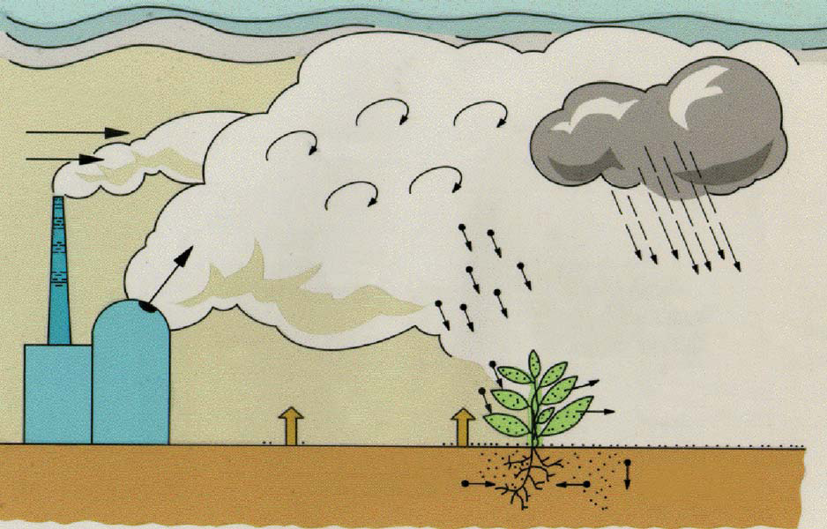
Dispersion in the Environment
height dependent
wind speed
rain
atmospheric turbulence
HT/HTO deposition
with conversion of
HT to HTO in soil
wet deposition
of HTO
HTO uptake
conversion to
OBT in plants
HTO reemission
from soil
HTO reemission
HTO uptake by
plant roots
HTO transport
into deeper soil
Adapted from:
Galeriu et al. Int. Conf. on tritium science and technology, Rochester (2007)

Slide 48
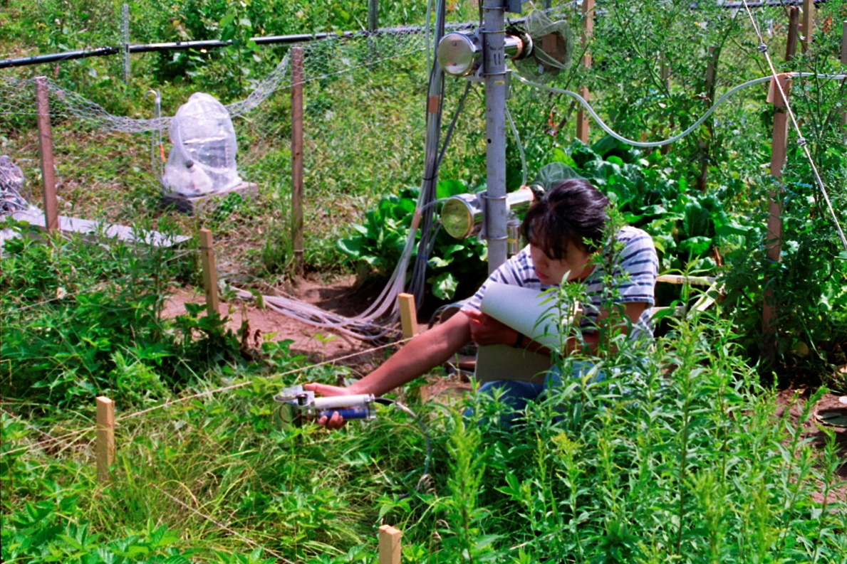
Dispersion in the Environment
Experimental field measurements of HT to HTO conversion
Chalk River 1994
Davis et al. Fusion Technology, 28, 840 (1995)
Photo: Siegfried Strack
Application: Data base for testing short-range HT dispersion models for regulatory compliance.
Peterson & Davis .Health Physics. 82(2):213-225, February 2002.

Slide 49
Dispersion in the Environment
HTO to OBT conversion in plants and animals in contaminated environments
49

Slide 50
Dispersion in the Environment
HTO to OBT conversion
Soil
10000
Vegetation
Meats, Milk, Eggs
1000
Vegetables, Fruits,
Tritium in moisture
Bq/L
Cereals
100
10
1
0.1
1
10
100
1000
10000
Distance from NGS - km
Kotzer & Workman. AECL-12029 (1999)
Brown. Atomic Energy Control Board INFO-0499 (1995)
50

Slide 51
Dispersion in the Environment
HTO to OBT conversion
Vegetation
Cereals
Eggs
Milk products
Meats
Fruit
Vegetables
0 1 2 3 4 5
Ratio of specific activities
[T/H]_{organic} to [T/H]_{water}
Average value 1.3; most within a factor of 2

Slide 52
Dispersion in the Environment
Estimated doses to public:
Typical food-basket
13–17% from OBT in food
relative to dose from HTO
Uncertainties point to:
  The need for studies of OBT through the food chain
  Improvements in models of tritium behaviour
Osborne. Tritium in the Canadian Environment. RSP-0153-1 CNSC (2002)

Slide 53
Dispersion in the Environment
1985
1990
1995
2000
2005
2010
BIOMOVS I & II
VAMP
Model intercomparisons and validation programs
BIOMASS
EMRAS I & II
MODARIA

Slide 54
Dispersion in the Environment
EMRAS Pickering (Canada) scenarios
Measurements of:
HTO in air, rain, soil, drinking water, plants, milk, meat
OBT in plant and animal samples
Given:
Measured concentrations of HTO in air, precipitation and drinking water
HTO in air
Calculate:
HTO and OBT in plants, milk and meat
HTO in top 5 cm soil layer
OBT in
meat

Slide 55
Dispersion in the Environment
Prediction from air concentration of HTO
200
150
100
50
0
OBT
in
meat
(Bq/L)
A B C D E F G
Measured
value
Model
Redrawn from: EMRAS Tritium/C14 Working Group Pickering Scenario IAEA (2006)

Slide 56
Dispersion in the Environment
Essential to continue to test and validate models for HTO, HT and OBT against new experimental and extant data

Slide 57
Health Effects
Exposures of workers and the public to tritium result from:
  Heavy water nuclear power plants and research laboratories
  Nuclear fuel reprocessing
  Nuclear weapons development and production
  Fusion reactor R&D
  Production of tritium sources for medical and industrial uses

Slide 58
Health Effects
Epidemiological studies
Significant effects observed
Public near nuclear facilities that release tritium
Nuclear workers exposed to tritium
None
None
Advisory Group on Ionising Radiation; UKHPA. Report RCE4 (2007)
Canadian Nuclear Safety Commission. Report INFO-0799 (2010)

Slide 59
Health Effects
Public doses from tritium
Most exposed < 20 µSv/a
Osborne. Tritium in the Canadian Environment. RSP-0153-1 CNSC (2002)

Slide 60
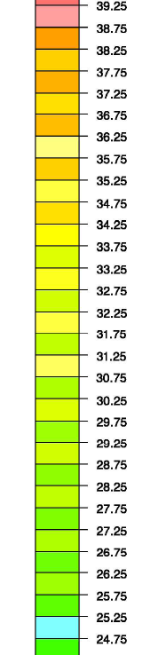
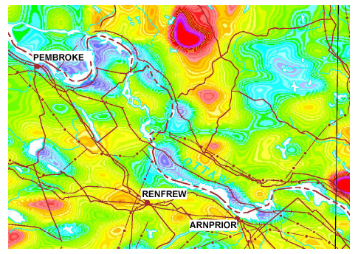
Extract from natural terrestrial radiation map of Canada
340
µSv/a
220 µSv/a
Range
120
µSv/a
RENFREW
COUNTY
100 km
Carson et al. Geological Survey of Canada, Open File 4460 (2003)

Slide 61
Health Effects
Occupational exposures to tritium
  Exposures have occurred in many nuclear facilities
  Tritium doses included in few studies only
  Not separated from other exposures
  Study specific to tritium should be possible
But:
  Small contribution to lifetime dose
  Low statistical power
  Old records may be unreliable

Slide 62
Health Effects
Number of workers = 5298
Collective dose = 10 person.Sv
Nominal excess cases = 0 –1
Little and Wakeford.
J. Radiol. Prot. 28 (2008)
UK AWE
UK Winfrith
UK Sellafield

Slide 63
Health Effects
Other cohorts?
South Korea
Romania
India
Argentina
USA
France
Russia
China
Number of workers = 22776
Collective dose = 164 person.Sv
Nominal excess cases = 8
Ashmore
Pers. Comm.(2012)
Canada NDR
UK AWE
UK Winfrith
UK Sellafield

Slide 64
Effluent Management
Issue
How do you assess the radiological importance of widely dispersed tritium?
64

Slide 65
Effluent Management
Collective dose as a measure of detriment from radiation
Optimization of protection through cost-benefit analysis
ICRP. Implications of Commission recommendations that doses be kept as low as reasonably achievable. Publication 22 (1973)
Application to tritium and other globally-dispersed radionuclides?
ICRP. Recommendations of the ICRP. Publication 26 (1977)
Optimum when marginal cost-effectiveness reaches chosen value of $ per man-sievert
Cost of
protective
measure
Weight to be given to small doses? Cut off?
NEA. Radiological significance and management of tritium, carbon-14, krypton-85, iodine-129 arising from the nuclear fuel cycle, OECD (1980)
Logically “No” following the linear no-threshold model for radiation risk
Collective dose (detriment)

Slide 66
Effluent Management
Not adding in small doses
  “ . . .had the same misleading character as the belief of Zenon . . . that Achilles would never beat the turtle”
    Lindell (1972) quoted by Taylor. Organization for radiation protection: The operations of the ICRP and NCRP 1928-1974 (1979)
Approach to optimization broadened
but the logic from LNT still applies
ICRP. 2007 Recommendations of the ICRP. Publication 103 (2007)

Slide 67
Effluent Management
“All models are wrong, but some are useful”
Box & Draper. Empirical Model-Building and Response Surfaces (1987)
Dosimetric concepts and quantities depend on LNT model
    e.g.
    Additivity of doses
    Incremental risk proportional to incremental dose
    Concept of effective dose
Good microdosimetric arguments for initial damage proportional to dose at very low doses
Beninson; Sievert lecture. 9th IRPA Congress (1996)

Slide 68
Effluent Management
Discussion often has the question ill posed
The “sucker’s choice”; LNT. “Yes” or “No”?
The probability of radiation carcinogenesis in an individual can well follow a LNT relationship with the magnitude of any single acute small radiation dose
What we observe in a population is the net of any such carcinogenic events from such single doses on individuals and any other positive or negative effects on health.
Gentner & Osborne.11th Pacific Basin Nuclear Conference Banff, Canada (1998)
Feinendegen et al. Health Physics 100, 274 (2011)

Slide 69
Effluent Management
LNT component is well quantified
But all effects are uncertain at low doses
Trans-science
No practical basis for estimating the statistical chances and consequences of the occurrence of these effects for any individual irradiation although we know they occur
Weinberg . Minerva 10: 209(1972)
No way of knowing a priori what an individual’s radiation
history will have been at the time of any exposure

Slide 70
Effluent Management
In a population, at what dose and dose rate combinations do the risks of radiogenic cancer start to outweigh the contribution of any stimulatory or adaptive effects to overall health outcome?
Challenge to experimentalists:
We need quantitative insights applicable to protection

Slide 71
Effluent Management
Implications:
  Still can base prospective radiation protection of individuals on LNT
  Logical justification for cutting off collective dose at low average individual doses; value to be determined
  RBE may be different for various phenomena underlying the different responses
  Cancer-prone animals not good models for radiation studies

Slide 72
Summary
Radiological protection encompasses a challenging variety of scientific disciplines
A solid grounding is needed in basic physics, chemistry, biology and mathematics (particularly statistics)
Be prepared to measure, don’t just model; be skeptical

Slide 73
Tritium:
Radiological characteristics are sufficiently understood for most practical health physics purposes
Many monitors are now available but better discrimination against radiation backgrounds is desirable
Dosimetric models can be improved with experimental data on OBT ingestion, particle inhalation, intake from surfaces and corresponding interpretation of bioassay results
Definitive measurement of RBE for mammalian carcinogenesis is needed, although keeping w_{R} =1 is sensible for protection purposes
Summary

Slide 74
Tritium:
Continuing intercomparison and validation of models for dispersion in the environmental are essential
Terrestrial and aquatic food chain studies are needed for HTO/OBT
No effects on health from tritium have been discernable in epidemiological studies
An international epidemiological study on the health of workers in many countries needs to be undertaken even though the expected statistical power is low
Appropriate consideration of small radiation doses to individuals from effluents depends on rethinking LNT
Need to recognize that the LNT carcinogenic response is modulated by other effects, which need to be quantified
Summary

Slide 75

adapted from

